Slide 1
Exam 70-774 Perform Cloud Data Science with Azure Machine Learning
Prepare Data for Analysis in Azure Machine Learning and Export from Azure Machine Learning
Develop Machine Learning Models
Operationalize and Manage Azure Machine Learning Services
Use Other Services for Machine Learning
Speaker Information:
https://www.microsoft.com/en-ie/learning/exam-70-774.aspx
Notes:
20533D
1: Introduction to Microsoft Azure

Slide 2
Prepare Data for Analysis in Azure Machine Learning and Export from Azure Machine Learning
Import and export data to and from Azure Machine Learning
Explore and summarize data
Cleanse data for Azure Machine Learning
Perform feature engineering
https://www.microsoft.com/en-ie/learning/exam-70-774.aspx

Slide 3
Prepare Data for Analysis in Azure Machine Learning and Export from Azure Machine Learning
Import and export data to and from Azure Machine Learning
Import and export data to and from Azure Blob storage, import and export data to and from Azure SQL Database, import and export data via Hive Queries, import data from a website, import data from on-premises SQL
Explore and summarize data
Create univariate summaries, create multivariate summaries, visualize univariate distributions, use existing Microsoft R or Python notebooks for custom summaries and custom visualizations, use zip archives to import external packages for R or Python
Cleanse data for Azure Machine Learning
Apply filters to limit a dataset to the desired rows, identify and address missing data, identify and address outliers, remove columns and rows of datasets
Perform feature engineering
Merge multiple datasets by rows or columns into a single dataset by columns, merge multiple datasets by rows or columns into a single dataset by rows, add columns that are combinations of other columns, manually select and construct features for model estimation, automatically select and construct features for model estimation, reduce dimensions of data through principal component analysis (PCA), manage variable metadata, select standardized variables based on planned analysis
https://www.microsoft.com/en-us/learning/exam-70-774.aspx
Notes:
The following topics are not included in this presentations due to time constrains
use existing Microsoft R or Python notebooks for custom summaries and custom visualizations
use zip archives to import external packages for R or Python

Slide 4
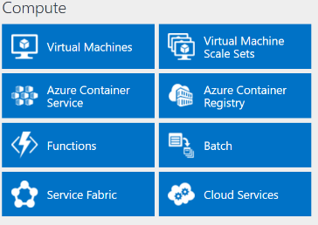
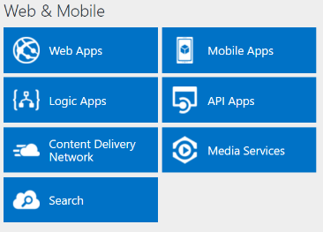
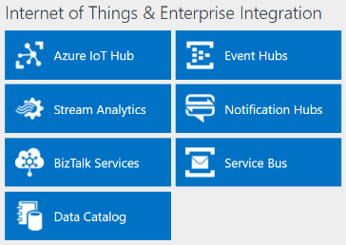
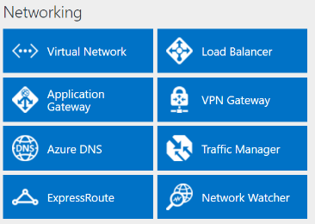
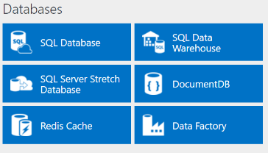
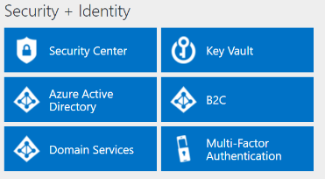
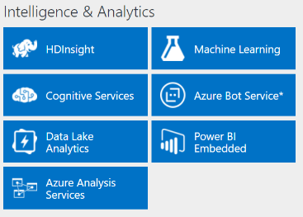
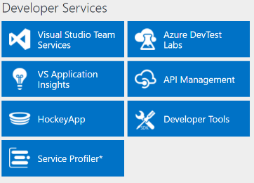
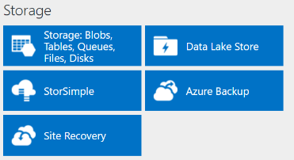
http://azureplatform.azurewebsites.net/
* Preview Services
Notes:
Preview Version 1.7 (2017-04-20)

Slide 5
What is Machine Learning?
Components of Machine Learning:
Machine Learning Studio, a graphical development environment
Data preprocessing modules
Machine learning algorithms
APIs to expose a model to applications
Pricing options for Machine Learning:
Free
Standard
Notes:
Machine Learning is a cloud service that runs on Microsoft Azure. Machine Learning is designed to
support both the development and the hosting of machine learning models.
Machine Learning Studio is used to manage the whole workflow.
The Machine Learning API has a RESTful interface, so that applications can access the model and use
its results.
Machine Learning uses a staged publishing model.
Free. The free tier supports a large subset of the Machine Learning service features, and includes 10
GB of data storage. The free tier does not support the deployment of models into production. This
tier is designed to enable long-term testing and evaluation of Machine Learning. The free tier
requires a Microsoft account, but not an Azure subscription.
Standard. The standard tier supports the complete Machine Learning feature set, together with
support for very large datasets. The standard tier includes a service level agreement (SLA) for Machine
Learning. The standard tier also requires an Azure subscription.
20774A
2: Introduction to Azure Machine Learning

Slide 6
Import and export data to and from Azure Machine Learning
Import and export data to and from Azure Blob storage, import and export data to and from Azure SQL Database, import and export data via Hive Queries, import data from a website, import data from on-premises SQL

Slide 7
Data structure
Growth of information storage capacity exceeds Moore’s Law
Businesses rarely throw data away
Growth of unstructured data much higher than growth of structured data
Essential to understand data structure types
Structured data:
RDMS, SQL Server, Excel
Unstructured data:
Text, blogs, images, audio, video
Notes:
As you introduce managing datasets, it might be helpful to remind students about the Team Data Science Process, and where they are in the life cycle. The graphic on the following page may be useful:
https://aka.ms/v7zune
it isn't enough to double capacity every 18 months, as specified by Moore's Law.
Structured data is a type of information that is stored in more traditional systems, such as relational databases and SQL Server applications, and Excel spreadsheets.
20774A
3: Managing Datasets

Slide 8
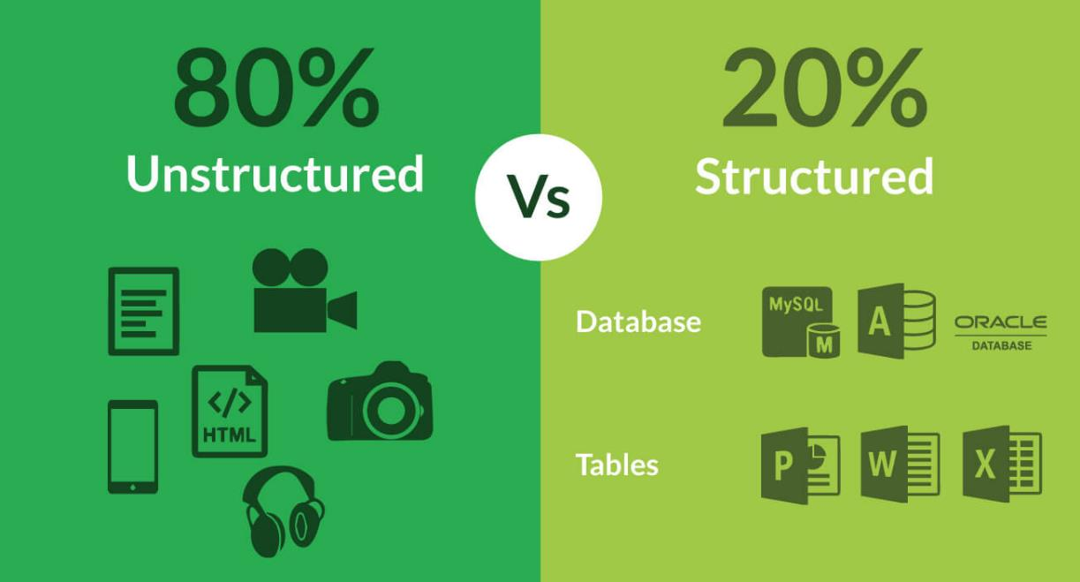
Data structure
http://upxacademy.com/beginners-guide-to-big-data/
Notes:
Structured data is a type of information that is stored in more traditional systems, such as relational databases and SQL Server applications, and Excel spreadsheets.
Unstructured data represents all the other types of information that businesses and organizations routinely collect and store.
without machine learning, much of this unstructured data is little or no value.
20774A
3: Managing Datasets

Slide 9
Dataset size and big data
Big data is challenging because:
It can have complex structures
It might have no structure at all
The data source might not be static
The three Vs:
Volume
Variety
Velocity
Big data technologies: Hadoop/HDInsight
Notes:
Big datasets can be challenging to clean, visualize and analyze.
20774A
3: Managing Datasets

Slide 10
Data purpose
Sample data
How was the sample made?
What criteria were used to create the sample?
Is the sample special?
Was there unconscious or subjective bias in the sample taking process?
Training data
70% training, 30% testing
70% training, 20% validation, 10% testing
Predictive data
Not the same as training data
Notes:
How you divide your source data into training and predictive data will depend on what type of data you are working with.
20774A
3: Managing Datasets

Slide 11
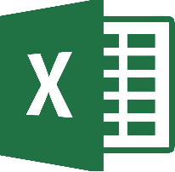


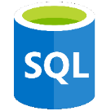


Importing data—Overview
Data Sources:
Offline
Online: live vs. cached
Generated
Data formats:
Txt, CSV, TSV, Excel
Azure table, Hive table
SQL database table
OData
SVMLight
ARFF, zip
RData
Data types:
String
Integer
Double
Boolean
DateTime
TimeSpan
Notes:
Machine Learning can import data from a variety of sources, such as Excel spreadsheets, Azure Blob storage, big data, SQL Server, and even simple CSV and text files.
Machine Learning has built-in tools to work with various types of data sources. Developers can also convert data types to other data types before the data reaches Machine Learning.
what might happen is that Machine Learning maintains a live link to an online source, you can use a cached copy of the data subsequent reruns of an experiment
20774A
3: Managing Datasets

Slide 12
Using online data sources
Online Data Sources
Web URL using HTTP
Hadoop using HiveQL
Azure Blob storage
Azure table
Azure SQL database
SQL Server on Azure VM
On-premises SQL Server database through the Management Gateway
OData
Notes:
As you learn about these types, note the access method of the data sources in Machine Learning. Each data source has to have different information to access the source.
For example, Azure SQL will need a URL, and an on-premises SQL database should have the name of the Data Management Gateway.
20774A
3: Managing Datasets

Slide 13
Using offline data sources
Offline Data Sources:
CSV
TSV
RData files
ARFF files
SVMLight
Notes:
You create a new Dataset module and upload your data from the file into this dataset.
There is an option to update datasets with new data as it becomes available, but this is not an automatic process
20774A
3: Managing Datasets

Slide 14
Import/Export from/to Azure Blob Storage
Importing from blob storage requires that
Data be stored in blobs that use the block blob format.
The files stored in the blob must use either comma-separated ( CSV) or tab-separated (TSV) formats.
When you read the file, the records and any applicable attribute headings are loaded as rows into memory as a dataset.
Saves data to the Blob service in Azure. This option is useful for
Images
Unstructured text
Binary data
Data in the Blob service can be shared publicly or saved in secured application data stores.
Notes:
https://docs.microsoft.com/en-us/azure/machine-learning/studio-module-reference/import-from-azure-blob-storage
https://docs.microsoft.com/en-us/azure/machine-learning/studio-module-reference/export-to-azure-blob-storage
20774A
3: Managing Datasets

Slide 15
Import/export data from/to Azure SQL Database
Storing data in Azure databases is more expensive than using tables or blobs in Azure.
There may also be limits on the amount of data
No transaction fees against SQL Azure Database,
Fast access to smaller amounts of frequently used information
You should also consider using a database and account that is in the same region as your machine learning workspace.
To export data, you provide the instance name and database name where the data is stored, and run the module using an account that has write permissions. You must also specify the table name, and map the columns from your experiment to columns in the table.
Notes:
To import data from a database, you must specify both the server name and database name, and a SQL statement that defines the table, view, or query.
https://docs.microsoft.com/en-us/azure/machine-learning/studio-module-reference/import-from-azure-sql-database
https://docs.microsoft.com/en-us/azure/machine-learning/studio-module-reference/export-to-azure-sql-database
20774A
3: Managing Datasets

Slide 16
Import and export data via Hive Queries
Importing data from Hive is particularly useful for loading large datasets, or if you want to pre-process the data using a MapReduce job before loading the data into a machine learning experiment.
This option is useful when you are working with very large datasets, and want to save your machine learning experiment data to a Hadoop cluster or HDInsight distributed storage. You might also want to export intermediate results or other data to Hadoop so that you can process it using a MapReduce job.
Notes:
https://docs.microsoft.com/en-us/azure/machine-learning/studio-module-reference/import-from-hive-query
https://docs.microsoft.com/en-us/azure/machine-learning/studio-module-reference/export-to-hive-query
20774A
3: Managing Datasets

Slide 17
Import data from a website
Data must be in one of the supported formats: CSV, TSV, ARFF, or SvmLight. Other data will cause errors.
No authentication is required or supported. Data must be publicly available.
Notes:
https://docs.microsoft.com/en-us/azure/machine-learning/studio-module-reference/import-from-web-url-via-http
20774A
3: Managing Datasets

Slide 18
Import data from on-premises SQL
Install a Microsoft Data Management Gateway that can access the data source
Register the gateway in your Azure Machine Learning workspace
Configure the Import Data to identify the gateway
Notes:
https://docs.microsoft.com/en-us/azure/machine-learning/studio-module-reference/import-from-on-premises-sql-server-database
20774A
3: Managing Datasets

Slide 19
Load data from Hadoop using Hive
Upload data to Azure Blob storage
Import data to Hive table
Access the Hadoop data using Hive query
Explore the data
Notes:
Explain that date information is very useful for many scenarios. In data warehousing, data information is an essential part of any business intelligence solution—because many business questions involve time. In this demonstration, you will upload date information into Azure Blob storage, specify the data that you want using HiveQL to shape the data, and then query the data.
There are several different ways to use Hive to access Hadoop queries:
The Hadoop Command Line
The Hive Editor
Azure PowerShell™ commands
In this demonstration, the Hive Editor will be used to shape and query the data held in Azure Blob storage.
Preparation Steps
You should create the Hadoop cluster before teaching this module; do not go into detail on Hadoop at this stage, as this is covered in Module 12 of this course.
The cluster deployment might take 20-30 minutes to complete.
Preparation steps:
Ensure that the MT17B-WS2016-NAT, 20774A-LON-DC, and 20774A-LON-DEV virtual machines are running.
On the 20774A-LON-DEV virtual machine, ensure that you are logged on as ADATUM\AdatumAdmin.
On the Start menu, start to type Internet Explorer, and then click Internet Explorer.
In Internet Explorer, in the address bar, type http://azure.microsoft.com, click Portal, and sign in using the Microsoft account that is associated with your Azure Learning Pass subscription.
In the Azure Portal, in the left-hand pane, click + New.
Click Data + analytics, and then click HDInsight.
Enter the following details, and then click Cluster type:
Cluster name: <your name><date>
Enter the following details, and then click Select:
Cluster type: Hadoop
Operating system: Linux
Version: (leave at default)
Enter the following details, and then click Next:
Cluster login username: hadmin
Cluster login password: Pa55w.rdPa55w.rd
Secure Shell (SSH) username: sadmin
Resource group (Create new): hadooprg
Location: Select your region
On the Storage blade, under Select a Storage account, click Create new.
In the Create a new Storage account box, type <your name><date>.
In the Default container box, replace the suggested name with the name of your cluster (for example, <your name><date>.
Leave all other settings at defaults, and click Next.
On the Cluster summary blade, next to Cluster size, click Edit.
On the Cluster size blade, in the Number of Worker nodes box, type 1.
Click Worker node size.
On the Choose your node size blade, click View all, then click A3 General Purpose, and then click Select.
Click Head node size.
On the Choose your node size blade, click View all, then click A3 General Purpose, and then click Select.
On the Cluster size blade, click Next.
On the Advanced settings blade, click Next.
On the Cluster summary blade, note the estimated cost per hour of this cluster; to avoid using up your Azure Pass allowance, it is important that you remove the cluster when you are not using it.
On the Cluster summary blade, click Create.
The deployment might take 20-30 minutes to complete.
Important: After you have taught this demonstration, delete the HDInsight cluster.

Slide 20
Notes:
Demonstration Steps
Upload data to Azure Blob storage
On the 20774A-LON-DEV virtual machine, ensure that you are logged in as ADATUM\AdatumAdmin.
On the Start menu, type Azure Storage, and then click Microsoft Azure Storage Explorer.
In the Connect to Azure Storage dialog box, ensure that Add an Azure Account is selected, and click Sign in.
In the Sign in to your account dialog box, enter the credentials of the Microsoft account that is associated with your Azure Learning Pass subscription, and click Sign in.
Under your Azure Learning Pass subscription, under Storage Accounts, expand the storage account as created in the preparation steps <your name><date>.
Expand Blob Containers, and then click the blob container as created in the preparation steps <your name><date>.
In the right-hand pane, click New Folder.
In the Create New Virtual Directory dialog box, in the Name box, type data, and then click OK.
In the right-hand pane, click Upload, and then click Upload Files.
In the click Upload files dialog box, on the right of the Files box, click the ellipses (…).
In the Select files to upload dialog box, browse E:\Demofiles\Mod03, click DimDate.csv, and then click Open.
In the Upload files dialog box, click Upload; wait until the file has been uploaded before proceeding to the next step.
Close Storage Explorer.
Import data to Hive table
On the toolbar, click Microsoft Edge.
In Microsoft Edge, in the address bar, type https://<Hadoop cluster name>.azurehdinsight.net, replacing <Hadoop cluster name> with the name of your cluster, and then press Enter.
In the Windows Security dialog box, enter the following credentials, and then click OK:
User name: hadmin
Password: Pa55w.rdPa55w.rd
In the Ambari console, in the top bar, click the set of squares icon, and then click Hive View.
Click Query.
In the Query Editor, type the following to create a table to hold the Hive information, and then click Execute:
CREATE EXTERNAL TABLE if not exists DimDate(PKIDDate INT, Day INT, DaySuffix STRING, DayOfWeek INT,
DayOfWeekName STRING, DOWInMonth INT, DayOfYear INT, WeekOfYear INT, WeekOfMonth INT, Month INT,
MonthName STRING, Quarter INT, QuarterName STRING, Year INT, StandardDate STRING, Season STRING)
ROW FORMAT DELIMITED
FIELDS TERMINATED BY ','
STORED AS TEXTFILE
LOCATION '/data'
TBLPROPERTIES("skip.header.line.count"="1");
The above command can be copied from: E:\Demofiles\Mod03\HiveTable.txt.
Before proceeding, wait until you see a “Status: SUCCEEDED” message, before proceeding.
Close Microsoft Edge.
(More notes on the next slide)
20774A
3: Managing Datasets

Slide 21
Notes:
Access the Hadoop data using Hive query
On the Start menu, type Internet Explorer, and then click Internet Explorer.
In Internet Explorer, in the address bar, type http://azure.microsoft.com, click Portal, and sign in using the Microsoft account that is associated with your Azure Learning Pass subscription.
In the Azure Portal, in the left-hand pane, click All resources, and then click your storage account.
Under Settings, click Access keys.
In the properties pane, next to key1, click the Click to copy icon.
In Internet Explorer, click + to create a new tab.
In Internet Explorer, in the address bar, type https://studio.azureml.net.
On the Microsoft Azure Machine Learning Studio page, click Sign In.
If you are prompted for credentials, use the details of the Microsoft Account that you created for this course.
In Microsoft Azure Machine Learning Studio, ensure that EXPERIMENTS is selected in the navigation pane, then click +New.
Click Blank Experiment.
In the Search experiment items box, type Import, and then from the module list, drag Import Data on to the experiment canvas.
In the right-hand Properties pane, in the Data source list, click Hive Query.
In the Properties pane, add the following information:
HCatalog server URI: insert the name of your cluster <your cluster name>.azurehdinsight.net.
Hadoop user account name: hadmin.
Hadoop user account password: Pa55w.rdPa55w.rd.
Location of output data: Azure Blob storage (WASB).
Storage account name: <your storage name>.
Storage key: Paste the key you copied earlier.
Container name: <your cluster name>.
In the Hive database query box, type SELECT * FROM DimDate.
Select the Use cached results check box; this will make it quicker when rerunning the experiment.
Click SAVE at the bottom of the page.
Click SAVE AS at the bottom of the page.
In the SAVE AS dialog box, in the EXPERIMENT NAME box, type Import Data using Hive Query, and click Ok (the tick).
To run the experiment, at the bottom of the page, click RUN.
When the experiment has finished running, all modules will show a green check mark to indicate that they have successfully finished; a “Finished” running status is also shown in the upper-right corner of the workspace.
(More notes on the next slide)
20774A
3: Managing Datasets

Slide 22
Notes:
Explore the data
In the Search experiment items box, type Summarize, and then from the module list, drag Summarize Data on to the experiment canvas.
Click the Import Data module, and you will see an output port on the bottom of the task.
To connect Summarize Data to Import Data, click the Import Data module, and the output node will show the number 1. Click the output node, and, keeping the mouse pressed down, draw a line from the Import Data module to the input (top) port of the Summarize Data module.
Click SAVE at the bottom of the page.
At the bottom of the page, click RUN.
When the experiment has finished running, all modules will show a green check mark to indicate that they have successfully finished.
Double-click the (lower) output port of the Summarize Data module, and then click Visualize.
Point out some of the key pieces of information, such as number of data points (54,787), missing values, and so on.
Point out that you can get a partial list of statistics by using the Visualize option in the Summarize Data task, but that it is limited to the top number of rows. To get more detail, the statistics can be written in a tabular dataset and explored in more detail using Excel, SQL Server or Power BI™.
Close the visualization by clicking the x at the top-right of the window.
Close Internet Explorer.
20774A
3: Managing Datasets

Slide 23
Load data from a website by using HTTP
Import CSV data from a web URL
Visualize the imported data
Add column names to imported data
Notes:
Point out that, in this demonstration, you first import data from a CSV file that does not contain any header metadata; you then add column names to make the data more meaningful.
Preparation Steps
Ensure that the MT17B-WS2016-NAT, 20774A-LON-DC, and 20774A-LON-DEV virtual machines are running, and that you are logged on to 20774A-LON-DEV as ADATUM\AdatumAdmin.
Demonstration Steps
Import CSV data from a web URL
On the 20774A-LON-DEV virtual machine, on the Start menu, type Internet Explorer, and then click Internet Explorer.
In Internet Explorer, in the address bar, type https:// studio.azureml.net.
On the Microsoft Azure Machine Learning Studio page, click Sign In.
If you are prompted for credentials, use the details of the Microsoft Account that you created for this course.
In Microsoft Azure Machine Learning Studio, ensure that EXPERIMENTS is selected in the navigation pane, then click +New.
Click Blank Experiment.
In the Search experiment items box, start to type Import, and then from the module list, drag Import Data on to the experiment canvas.
In the right-hand Properties pane, in the Data source list, select Web URL via HTTP.
In the Data source URL box, type http://mlr.cs.umass.edu/ml/machine-learning-databases/autos/imports-85.data
(The above URL can be copied from E:\Demofiles\Mod03\WebURL.txt.)
In the Data format list, select CSV.
Select Use cached results; this will make it quicker when rerunning the experiment.
At the bottom of the page, click SAVE, then click SAVE AS.
In the EXPERIMENT NAME box, type Import from Web URL, and then click the tick.

Slide 24
Notes:
Visualize the imported data
Run the experiment, by clicking RUN at the bottom of the page.
When the experiment has finished running, all modules will show a green check mark to indicate that they have successfully finished; a Finished running status is also shown in the upper-right corner of the workspace.
Wait until the experiment has successfully completed.
Double-click the (lower) output port of the Import Data module, and then click Visualize.
Point out that the column names are not present in the data, so the data does not make much sense. In the next set of steps, column names will be added.
Click the x at the top-right of the page, to close the visualization page.
Add column names to imported data
In the Search experiment items box, start to type Edit, and then from the module list, drag Edit Metadata on to the experiment canvas.
Click the Import Data module, and you will see an output port on the bottom of the task.
Connect Edit Metadata to Import Data. To do this, click the Import Data module, and the output node will show the number 1. Click the output node and, keeping the mouse pressed down, draw a line from the Import Data module to the input (top) port of the Edit Metadata module.
Click the Edit Metadata module, and in the Properties pane, click Launch Column Selector.
In the Select columns dialog box, ensure that BY NAMES is selected on the left-hand side.
Under AVAILABLE COLUMNS, select all the columns, and click the right arrow, so that they are listed under SELECTED COLUMNS, then click the check mark (tick) to confirm the change.
In the Properties pane, in the New column names box, type the following:
symboling,normalized-losses,make,fuel-type,aspiration,num-of-doors,body-style,drive-wheels,engine-location,wheel-base,length,width,height,curb-weight,engine-type,num-of-cylinders,engine-size,fuel-system,bore,stroke,compression-ratio,horsepower,peak-rpm,city-mpg,highway-mpg,price
(The above list can be copied from E:\Demofiles\Mod03\ColumnNames.txt.)
Run the experiment, by clicking RUN at the bottom of the page.
When the experiment has finished running, all modules will show a green check mark to indicate that they have successfully finished.
Click SAVE at the bottom of the page.
Double-click the (lower) output port of the Edit Metadata module, and then click Visualize.
Point out that, now, the results make more sense with the column names that have been added to the data.
Close the visualization by clicking the x at the top-right of the window.
(More notes on the next slide)
20774A
3: Managing Datasets

Slide 25
Notes:
(More notes on the next slide)
20774A
3: Managing Datasets

Slide 26
True or False: If you define a dataset using the Dataset module, this data is only available during the run of that experiment.
False
True

Slide 27
True or False: If you define a dataset using the Dataset module, this data is only available during the run of that experiment.
False

Slide 28
Explore and summarize data
Create univariate summaries, create multivariate summaries, visualize univariate distributions, use existing Microsoft R or Python notebooks for custom summaries and custom visualizations, use zip archives to import external packages for R or Python

Slide 29
Exploring data
Exploring data is the key step:
Descriptive statistics
Data export
Power BI
Summarizing data:
How many records are there?
Are there missing values?
How many unique values are there?
Mean, standard deviation, and so on
Notes:
Descriptive statistics: Machine Learning includes tasks and visualization features to help you to gain a “big picture” overview of a dataset. For example, you can use the Visualize
Data export. You can export summary statistics from Machine Learning to a CSV file, which can then be used for further exploration and visualization
Power BI to create visualizations, such as graphs, charts, scatter plots, Geo maps, and so on
the generation of summary statistics can help you see what type of data you have
20774A
3: Managing Datasets

Slide 30
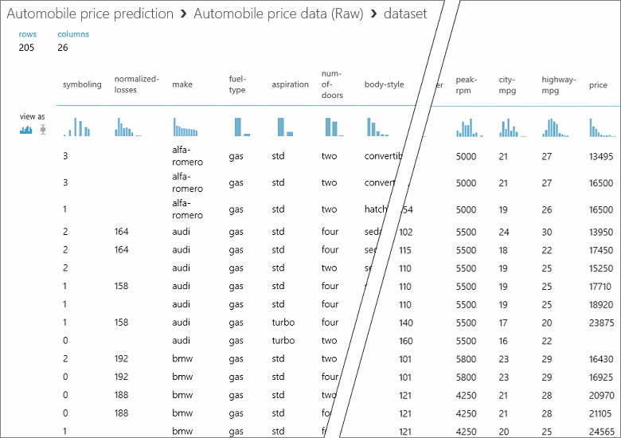
Visualization
Notes:
20774A
3: Managing Datasets

Slide 31
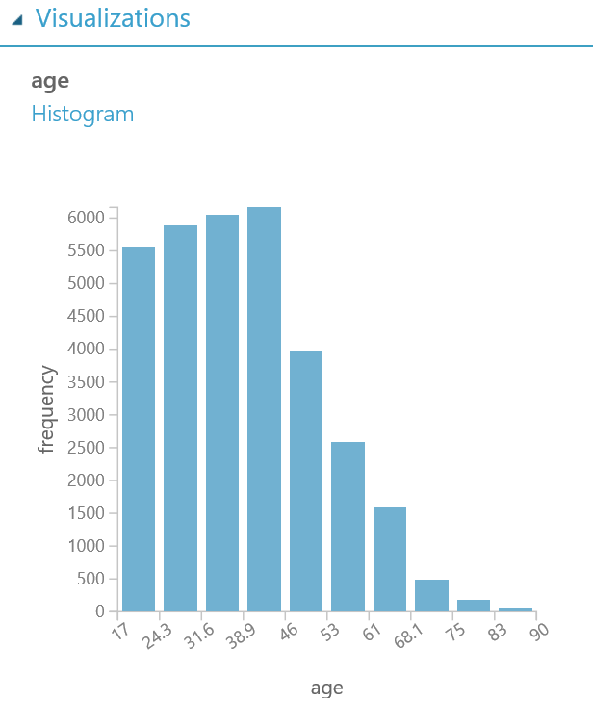
Visualization
Notes:
20774A
3: Managing Datasets

Slide 32
Summarize Data
Understanding the characteristics of the complete dataset.
How many missing values are there in each column?
How many unique values are there in a feature column?
What is the mean and standard deviation for each column?
The module calculates the important scores for each column, and returns a row of summary statistics for each variable (data column) provided as input.
Notes:
https://docs.microsoft.com/en-us/azure/machine-learning/studio-module-reference/summarize-data
20774A
3: Managing Datasets

Slide 33
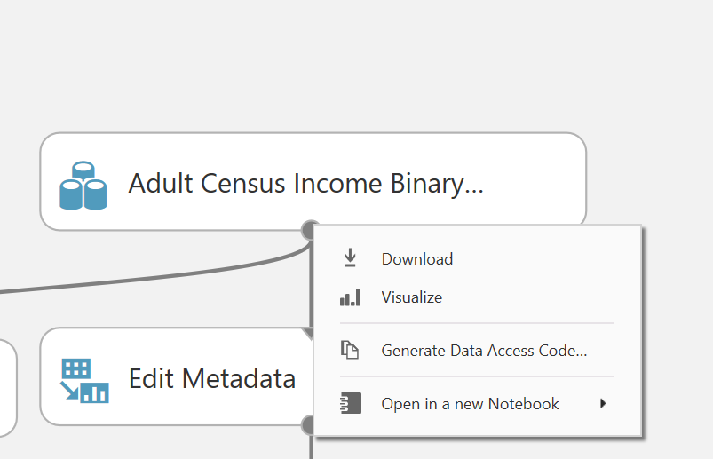
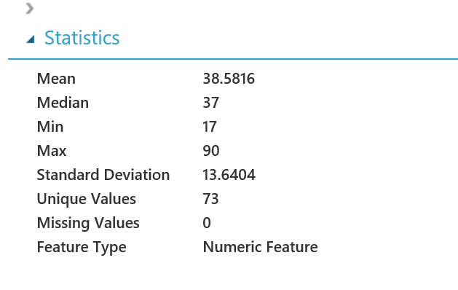
Univariate summaries

Slide 34
Group Categorical Values
Merge multiple string values into a single new level
You can create groupings only for categorical columns
Not to columns of numeric type or columns designated as labels or features
Any column values that are not explicitly mapped to a new level are assigned to a default level
Notes:
https://docs.microsoft.com/en-us/azure/machine-learning/studio-module-reference/group-categorical-values
20774A
3: Managing Datasets

Slide 35
Group Data into Bins
You can customize how the bin edges are set and how values are apportioned into the bins.
Manually type a series of values to serve as the bin boundaries.
Calculate entropy scores to determine an information values for each range, to optimize the bins in the predictive model.
+ Assign values to bins by using quantiles, or percentile ranks.
Control the number of values in each bin can also be controlled.
Force an even distribution of values into the bins
Notes:
https://docs.microsoft.com/en-us/azure/machine-learning/studio-module-reference/group-data-into-bins
20774A
3: Managing Datasets

Slide 36
Transforming data
Adding data
Small sample size
Missing data
Removing data
Duplicate records
Numerical encoding
Text to numbers
Data conversion
Convert values to another value type
Applying data transformations
SQL queries
R or Python code
Machine Learning modules
Notes:
You might want to add records to a dataset, if you do not have a sufficient sample size from one dataset; for example, you might need to merge data from another dataset using some form of join.
There might be duplicate records in your dataset, so another common preprocessing step is to identify the duplicate rows, and then remove them
You might want to convert values of one type into another type, such as a decimal value into an integer, or a text-based date format into a machine date.
If you're using Azure Machine Learning Studio, there are data transformation modules that can be configured for a wide range of preprocessing transformation tasks.
20774A
3: Managing Datasets

Slide 37
Visualize data
Select Data
Remove Data
Edit Data
Notes:
Explore different modules and their effect on data.
Optional Demo

Slide 38
If you want to return just the top 1,000 rows of a dataset, which Machine Learning modules would you use?
Partition and Sample Module
Split Data Module
Split Data Module with the Head option
Partition Data Module
Partition and Sample Module with the Head option

Slide 39
If you want to return just the top 1,000 rows of a dataset, which Machine Learning modules would you use?.
Partition and Sample Module with the Head option

Slide 40
Cleanse data for Azure Machine Learning
Apply filters to limit a dataset to the desired rows, identify and address missing data, identify and address outliers, remove columns and rows of datasets

Slide 41
Introduction to data preprocessing
Data preprocessing:
Identifying issues requires thorough data exploration
Power BI can help during exploration phase
Issues can include:
Missing information or incomplete records
Noisy data with outliers
Other inconsistencies and discrepancies
Tools for preprocessing:
SQL or Hive queries
R or Python scripts
Machine Learning modules
Notes:
As you introduce data preprocessing, it might be helpful to remind students about the Team Data Science Process, and where they are in the life cycle. The graphic on the following page might be useful:
https://aka.ms/v7zune
you need to get the data into proper shape before you can start the modeling process.
20774A
4: Preparing Data for use with Azure Machine Learning

Slide 42
Cleaning data
Cleaning data involves:
Resolving missing values
Updating or removing incorrect values
Methods for cleaning data:
Machine Learning modules
R scripts
Notes:
https://docs.microsoft.com/en-us/azure/machine-learning/studio-module-reference/clean-missing-data
Cleaning data means that you maximize your opportunity to build models that perform effectively
20774A
4: Preparing Data for use with Azure Machine Learning

Slide 43
Normalizing data
Normalization:
Transform data to a common scale
Create consistent scales across data sources
Change absolute values to a scale or percentage
Normalize Data module methods:
Zscore
MinMax
Logistic
LogNormal
TanH
Notes:
referred to as scaling
such as when you want to change a set of absolute values to a 0-1 scale,
• Zscore. All values are converted to a z-score.
• MinMax. All values are linearly rescaled between 0 and 1.
• Logistic. All values are transformed using a logistic function.
• LogNormal. All values are converted to a lognormal scale.
• TanH. All values are converted to a hyperbolic tangent.
20774A
4: Preparing Data for use with Azure Machine Learning

Slide 44
Reducing data complexity
Grouping to reduce complexity
Quantization:
Continuous data to bins/buckets
For example:
Ages: 0-10, 11-20, 21-30, and so on
Group Data into Bins module
Lookup tables:
Category data to smaller set
For example:
Car models to type: SUV, sedan, station wagon, and so on
Group Categorical Values module
R script
Notes:
When you bin data, you look at data that has continuous features—such as age, for example—and group this continuous data for further analysis. This is known as binning, or bucketing the data, and is done using a technique called quantization.
The Group Data into Bins module supports a user-defined number of buckets and multiple quantile normalization functions such as Percent, Percentage Quartile, and Quartile Index. The output from the Group Data into Bins module can then be used as the input for further processing and analysis.
20774A
4: Preparing Data for use with Azure Machine Learning

Slide 45
Handling missing data
Methods for handling missing data include:
Removing records that include missing values
Replacing missing data with an average value
Replacing missing values with the most likely value
Replacing missing values with a marker
Notes:
Missing data can lead to erroneous or unreliable results. Missing data can also lead to bad testing, which hurts the trustworthiness of your models.
Removing records that contain missing values. This can
be effective if the proportion of missing values is very low, or if the data is sampled anyway—for
example, if the data is used to train a model.
• Replace missing data with an average value. You could use a mean, median, or mode value,
depending on the data.
• Replace missing values with the most likely value. If missing values are typical when the true value is
0, or a zero-length string, then you could replace it with this value.
• Replace missing values with a marker. This could be a text string, or, in the case of a number, a
negative value or 0. Care should be taken that these values are not included in aggregates.
• When replacing a missing value, it is often appropriate to add a value to mark it as a missing value.
This can be used to lower the confidence in the value, or ignore it entirely.
20774A
4: Preparing Data for use with Azure Machine Learning

Slide 46
Dealing with outliers
Outliers can negatively affect results
In some situations outliers contain useful data
The Clip Values module can remove outliers
Notes:
Typically, you remove values that are outside a set range, or a set percentage of values.
20774A
4: Preparing Data for use with Azure Machine Learning

Slide 47
Working with imbalanced data
Imbalanced data can lead to some classes being underrepresented
SMOTE can be used to rebalance data
Care should be taken to ensure model accuracy
Notes:
This issue could be due to incorrect sampling of the data, or merely that the class itself is rare.
—it’s named Synthetic Minority Oversampling Technique (SMOTE).
The SMOTE module works by inflating the percentage of minority cases so that the dataset is rebalanced.
20774A
4: Preparing Data for use with Azure Machine Learning

Slide 48
Pre-processing data using Machine Learning
Use the Summarize module to identify issues with imported raw data
Clean the import to remove rows with missing data
Remove outliers from the imported data
Notes:
Use dataset from the titanic
On the Start menu, start to type Internet Explorer, and then click Internet Explorer.
In Internet Explorer, in the address bar, type https://studio.azureml.net/.
On the Microsoft Azure Machine Learning Studio page, click Sign In.
If you are prompted for credentials, use the details of the Microsoft account that you created for this course.
Ensure that EXPERIMENTS is selected in the navigation pane, then click + NEW.
Click Blank Experiment.
In the Search experiment items box, type My Datasets, and then from the module list, drag titanic_full_data.csv on to the experiment canvas.
Demonstration Steps
Use the Summarize module to identify issues with imported raw data
In Machine Learning Studio, ensure that the Preprocessing Demo experiment is open, and that EXPERIMENTS is selected in the navigation pane.
In the Search experiment items box, type Summarize, and then from the module list, drag Summarize Data on to the right-hand side of the experiment canvas.
Connect the Import Data module to the input port of the Summarize Data module.
Run the experiment, by clicking RUN at the bottom of the page.
When the experiment has run successfully, right-click the output port of the Summarize Data module, and then click Visualize.
Clean the import to remove rows with missing data
In the Search experiment items box, type Clean, and then from the module list, drag Clean Missing Data on to the experiment canvas.
Connect the input port of the Clean Missing Data module to the output port of the Import Data module.
Click the Clean Missing Data module, and in the Properties pane, under Cleaning mode, click Remove entire row.

Slide 49
Notes:
Run the experiment, by clicking RUN at the bottom of the page.
Click the left-hand output port of the Clean Missing Data module, and then click Visualize.
Remove outliers from the imported data
Right-click the output port of the Summarize Data module, and then click Visualize.
Point out that the Age field shows a Max value of 90; Close the visualization by clicking the x at the top-right of the window.
In the Search experiment items box, type Clip, and then from the module list, drag Clip Values on to the experiment canvas.
Connect the input port of the Clip Values module to the output port of the Import Data module.
Click Clip Values, and in the Properties pane, click Launch column selector.
In the Select Columns dialog box, change the Include option from column type to column names, and in the box, select OutstandingBalance, then click the tick.
In the Properties pane, set the following values:
Set of thresholds: ClipPeaks
Upper threshold: Constant
Constant value for upper threshold: 90
Upper substitute value: 75
Run the experiment, by clicking RUN at the bottom of the page.
When the experiment has finished running, all modules will show a green check mark to indicate that they have successfully finished.
When the experiment has run successfully, right-click the output port of the Clip Values module, and then click Visualize.
(More notes on the next slide)
20774A
4: Preparing Data for use with Azure Machine Learning

Slide 50
Which module in Machine Learning deals with outliers?
Remove Outliers Module
Normalize Data Module
Reduce Errors Module
Clip Value Module
Minimize Scatter Module

Slide 51
Which module in Machine Learning deals with outliers?
Clip Value Module

Slide 52
Perform feature engineering
Merge multiple datasets by rows or columns into a single dataset by columns, merge multiple datasets by rows or columns into a single dataset by rows, add columns that are combinations of other columns, manually select and construct features for model estimation, automatically select and construct features for model estimation, reduce dimensions of data through principal component analysis (PCA), manage variable metadata, select standardized variables based on planned analysis

Slide 53
Feature engineering overview
Feature Engineering
Generates additional features
Combines existing features
Provides Data Transformation
Notes:
As you introduce feature engineering and selection, it might be helpful to remind students about the Team Data Science Process, and where they are in the life cycle. The graphic on the following page might be useful: https://aka.ms/v7zune
Feature engineering and feature selection techniques are designed to help increase the predictive power of machine learning models. In the Team Data Science Process (TDSP), feature engineering and selection are part of the modeling phase.
In a typical workflow, you would first use feature engineering to generate these additional features, and then use feature selection to help filter out or eliminate any features that are deemed to be irrelevant, or redundant, or which are highly correlated.
will depend on the type of data you have, and the objective of your machine learning model.
public holidays, or were at weekends. In this case, you might create several new features that categorize your days
20774A
5: Using Feature Engineering and Selection in Azure Machine Learning

Slide 54
Merging datasets
Merging datasets:
Main dataset plus update dataset to enrich the source data
Datasets from two or more sources
Machine Learning modules:
Join Data
Add Rows
Add Columns
Notes:
Add Columns takes the columns on the left-hand side and puts them next to the columns on the
right side. However, note that this is a very simple adding of columns together. The number of
columns in the new dataset is the sum of all of the columns of both input datasets.
Add Rows appends one dataset to another. Two data tables can be added at a time. The data source
on the left-hand side is regarded as the first series of rows, and the data source that is added to the
right-hand data source is appended to the first dataset.
20774A
5: Using Feature Engineering and Selection in Azure Machine Learning

Slide 55
Merging and combining data
Merging data:
Combine columns into a single set of predictive data
Rolling aggregates for time-series data
Calculated features
Tools for merging and combining data:
Custom R scripts
SQL, Python, or Hive queries
Machine Learning modules, such as Feature Hashing and Apply SQL Transformation
Notes:
For example, if you have a dataset of hourly sales transactions, and you wish to develop a predictive model using weather as one of your predictive inputs, you might wish to roll up your hourly records into a daily or even weekly summary. This is because it is unlikely that sales and weather would correlate on a short timescale such as per hour—but they are quite likely to correlate over a longer time period.
By having your detailed sales transaction dataset—with the time and date of each transaction as separate records—you would combine all these records for a particular date into one record. Although this step means that you are losing some detailed information—in other words, the time of day a particular transaction occurred—this doesn’t matter, because the question you’re answering is about daily sales, not hourly ones.
Typical scenarios include:
• Rolling aggregates for time-series data. There is often too much data, and in its raw form, this has
little value. For example, time-stamped output from telemetry sensors in engineering plant, or sales
information by individual time-stamped transaction. Such data could be rolled up into features such
as Average sensor reading by hour, Peak daily sensor reading, Total weekly revenue, Average
revenue per month, and so on.
• Calculated features. Datasets can often be missing a crucial feature—but one that is simple to
calculate or derive from other information. For example, if you are trying to predict rail journey times,
but your data only includes arrival a
20774A
5: Using Feature Engineering and Selection in Azure Machine Learning

Slide 56
Using Join to merge data
Create a transaction dataset by importing from Azure SQL Database
Upload a date dataset from a flat file
Add the second dataset to an experiment
Join the transaction and date datasets
Notes:
Preparation Steps
Demo files are on the github repo
This demo requires an Azure SQL Database called WideWorldImporters-Standard. Before running this demo, you must complete the following steps:
On the 20774A-LON-DEV virtual machine, in Internet Explorer®, in the address bar, type http://azure.microsoft.com, click Portal, and sign in using the Microsoft account that is associated with your Azure Learning Pass subscription.
In the Azure Portal, in the left-hand pane, click +New.
Select Databases, and then select SQL Database.
Enter the following details, and then click Server:
Name: WideWorldImporters-Standard
Resource group (create new): <your name>rg
Select source: Blank database
On the New server pane, enter the following details, and then click Select:
Server name: <your name><date>
Server admin login: dbadmin
Password: Pa55w.rd
Confirm password: Pa55w.rd
Location: Select your region
Click Pricing tier, click Standard, and then click the left-hand end of the DTU slider, so that the DTU box shows 10 (S0).
Click Apply.

Slide 57
Notes:
Leave all other details at their defaults, and click Create.
Make a note of the database and server names that you used.
Wait until you see a message that the deployment has been successful.
In the Navigation pane, click All resources, and then click WideWorldImporters-Standard.
On the WideWorldImporters-Standard blade, click the Server name, and then on the Settings blade, click Firewall.
Click Add client IP, and then click Save, to add your current IP address to the list of allowed IP addresses.
Click OK, and then close the Firewall settings, Settings and server blades.
On the 20774A-LON-DEV virtual machine, right-click Start, and then click Command Prompt (Admin).
In the User Account Control dialog box, click Yes.
In the Command Prompt window, type the following command, and press Enter:
CD C:\Program Files (x86)\Microsoft SQL Server\130\DAC\Bin
In the Command Prompt window, type the following command (replacing <your db servername> with the name of your database server), and press Enter:
SqlPackage.exe /a:import /tcs:"Data Source=<your db servername>.database.windows.net;Initial Catalog=WideWorldImporters-Standard;User Id=dbadmin;Password=Pa55w.rd" /sf:E:\Demofiles\Mod05\WideWorldImporters-Standard.bacpac /p:DatabaseEdition=Standard /p:DatabaseServiceObjective=S0
The above command can be copied from E:\Demofiles\Mod05\SqlPackageCmd.txt
(More notes on the next slide)
20774A
5: Using Feature Engineering and Selection in Azure Machine Learning

Slide 58
Notes:
Wait until you get the Successfully imported database message.
Close the command prompt.
In the Azure Portal, in the Navigation pane, click All resources, and then click WideWorldImporters-Standard.
On the Overview pane, click Tools.
On the Tools pane, click Query editor (preview).
In the Query editor (preview), click Login.
Enter the following details, and then click OK:
Authorization type: SQL server authentication
Login: dbadmin
Password: Pa55w.rd
Click in line 1, type the following command, and then click Run:
CREATE SCHEMA [20774A] AUTHORIZATION db_owner;
GO
EXECUTE sp_addextendedproperty @name = N'Description',
@value = N'Schema for AzureML data import.', @level0type = N'SCHEMA', @level0name = N'20774A';
The above command can be copied from E:\Demofiles\Mod05\SqlSchemaCmd.txt.
Delete the commands.
(More notes on the next slide)
20774A
5: Using Feature Engineering and Selection in Azure Machine Learning

Slide 59
Notes:
Click in line 1, type the following command, and then click Run:
IF EXISTS (SELECT * FROM sys.views WHERE name = '20774A.CustomerTransactions')
DROP VIEW [20774A].[CustomerTransactions]
GO
IF OBJECT_ID('[20774A].[CustomerTransactions]', 'V') IS NOT NULL
DROP VIEW [20774A].[CustomerTransactions]
GO
CREATE VIEW [20774A].[CustomerTransactions]
AS
SELECT customers.CustomerName,
CAST( [TransactionAmount] AS REAL) AS TransactionAmount,
CAST([OutstandingBalance] AS REAL) AS OutstandingBalance,
CAST([TaxAmount] AS REAL) AS TaxAmount,
CONCAT(
(LEFT([TransactionDate],4)),RIGHT(LEFT([TransactionDate],7),2),RIGHT(LEFT([TransactionDate],10),2)
) AS PKIDDate
,[TransactionDate]
FROM [Sales].[Customers] AS customers
LEFT OUTER JOIN
[Sales].[CustomerTransactions] AS customertransactions
ON customers.CustomerID = customertransactions.CustomerID;
The above command can be copied from E:\Demofiles\Mod05\SqlViewCmd.txt.
(More notes on the next slide)
20774A
5: Using Feature Engineering and Selection in Azure Machine Learning

Slide 60
Notes:
In Internet Explorer, click + to create a new tab, and in the address bar, type https://studio.azureml.net/.
On the Microsoft Azure Machine Learning Studio page, click Sign In.
If you are prompted for credentials, use the details of the Microsoft account that you created for this course.
In Microsoft Azure Machine Learning Studio, ensure that DATASETS is selected in the navigation pane, then click + New.
Click FROM LOCAL FILE.
In the Upload a new dataset dialog box, click Browse.
In the Choose file to upload dialog box, navigate to E:\Demofiles\Mod05, click DimDate3.csv, and then click Open.
In the ENTER A NAME FOR THE NEW DATASET box, type DateHolidayPromo.
In the SELECT A TYPE FOR THE NEW DATASET list, select Generic CSV File with a header (.csv).
Click the check mark (tick).
Demonstration Steps
Import transaction data from Azure SQL Database
On the 20774A-LON-DEV virtual machine, in the Microsoft Azure Machine Learning Studio page, click Sign In.
If you are prompted for credentials, use the details of the Microsoft account that you created for this course.
Ensure that EXPERIMENTS is selected in the navigation pane, then click + NEW.
Click Blank Experiment.
In the Search experiment items box, type Import, and then from the module list, drag Import Data on to the experiment canvas.
(More notes on the next slide)
20774A
5: Using Feature Engineering and Selection in Azure Machine Learning

Slide 61
Notes:
In the right-hand Properties pane, in the Data source list, select Azure SQL Database.
In the Database server name box, type the following (replacing <your db servername> with the name of your database server created in the preparation steps):
<your db servername>.database.windows.net
In the Database name box, type WideWorldImporters-Standard.
In the User name box, type dbadmin.
In the Password box, type Pa55w.rd.
In the Database query box, type the following command to use a subset of the total data:
SELECT * From [20774A].[CustomerTransactions]
Select Use cached results.
In the Search experiment items box, type Summarize, and then from the module list, drag Summarize Data on to the right-hand side of the experiment canvas.
Connect the Import Data module to the input port of the Summarize Data module.
Click SAVE AS at the bottom of the page.
In the EXPERIMENT NAME box, type Shaping Demo, and click the tick.
Run the experiment, by clicking RUN at the bottom of the page.
When the experiment has run successfully, right-click the output port of the Summarize Data module, and then click Visualize.
Point out that there are six rows or features being imported from the Azure SQL Database.
Close the visualization by clicking the x at the top-right of the window.
Click SAVE at the bottom of the page.
(More notes on the next slide)
20774A
5: Using Feature Engineering and Selection in Azure Machine Learning

Slide 62
Notes:
Add date data to the experiment
In Microsoft Azure Machine Learning Studio, click EXPERIMENTS, click MY EXPERIMENTS, and then click Shaping Demo.
In the Search experiment items box, type Date, and then from the module list, drag DateHolidayPromo on to the left side of the experiment canvas, to the left of the Import Data module.
In the Search experiment items box, type Summarize, and then from the module list, drag Summarize Data on to the left-hand side of the experiment canvas, and below DateHolidayPromo.
Connect the output port of DateHolidayPromo to the input port of Summarize Data.
Run the experiment, by clicking RUN at the bottom of the page.
Point out that, by running the experiment, Machine Learning Studio can pick up the metadata for the DateHolidayPromo dataset.
When the experiment has finished running, click the output port of the Summarize Data module that you just added, and then click Visualize.
Note that there are 18 rows (features) in this dataset.
Close the visualization by clicking the x at the top-right of the window.
Join the transaction and date datasets
In the Search experiment items box, type Join, and then from the module list, drag Join Data on to the experiment canvas, between and below DateHolidayPromo and Import Data.
Connect the output port of DateHolidayPromo to the left-hand input port of Join Data.
Connect the output port of Import Data to the right-hand input port of Join Data.
Explain that you now need to configure the join; for both the Import Data and DateHolidayPromo datasets, the common key is a date field, called PKIDDate.
Click the Join Data module, and in the Properties pane, under Join key columns for L, click Launch column selector.
(More notes on the next slide)
20774A
5: Using Feature Engineering and Selection in Azure Machine Learning

Slide 63
Notes:
In the Select columns dialog box, under AVAILABLE COLUMNS, click PKIDDate, and then click the right arrow.
Click the check mark (tick).
In the Properties pane, under Join key columns for R, click Launch column selector.
In the Select columns dialog box, under AVAILABLE COLUMNS, click PKIDDate, and then click the right arrow.
Click the check mark (tick).
In the Search experiment items box, type Summarize, and then from the module list, drag Summarize Data on to the experiment canvas, below Join Data.
Connect the output port of the Join Data module to the input port of Summarize Data.
Run the experiment, by clicking RUN at the bottom of the page.
When the experiment has finished running, click the output port of the Summarize Data module that you just added, and then click Visualize.
Note that there are now 24 rows (features) in the joined data, and that the columns from both source tables are now listed in the Feature column.
Close the visualization by clicking the x at the top-right of the window.
Click SAVE at the bottom of the page.
20774A
5: Using Feature Engineering and Selection in Azure Machine Learning

Slide 64
Which function in Machine Learning should you call if you want to merge data horizontally by adding more columns to enrich your dataset?
Merge Data
Add Data
Include Data
Fill Data
Join Data

Slide 65
Which module in Machine Learning deals with outliers?
Join Data

Slide 66
Feature selection overview
Feature Selection
Filters out irrelevant features
Distinguishes classes of objects dependent on their relationships
Notes:
You will learn about how you can focus machine learning on the specific pieces of information that will be most useful for further modeling and testing.
The goal with feature selection is to train a model using the smallest set of independent variables that can explain the patterns discovered in the dataset, and that can then be used for successful outcome prediction.
two common reasons for using feature selection:
• Increasing the accuracy of model predictions, by removing the unnecessary and redundant data.
• Increasing the efficiency of the model training process, by reducing the number of features and therefore reducing the computational demands;
it is simply a case of choosing or selecting those features to use for subsequent analysis.
20774A
5: Using Feature Engineering and Selection in Azure Machine Learning

Slide 67
Reducing data dimensions
Reducing data dimensions:
Uses data transformation, and other methods, to modify the original features
Examples:
Principal Component Analysis (PCA)
Canonical correlation analysis
Singular Value Decomposition
Learning with Counts modules:
Build Counting Transform
Export Count Table
Import Count Table
Merge Counting Transform
Modify Count Table Parameters
Notes:
Reducing data dimensions is not strictly speaking the same thing as feature selection. Feature selection is all about producing a subset of the original data, without changing any of the original features. By contrast, the mention reduction uses data transformation, and other methods, to modify the original features in some way.
https://docs.microsoft.com/en-us/azure/machine-learning/studio-module-reference/data-transformation-learning-with-counts
20774A
5: Using Feature Engineering and Selection in Azure Machine Learning

Slide 68
Selecting features
Selecting features
Tools:
Filters
For example, moving averages, moving medians, waveform decomposition
Edit metadata
Notes:
You could also use mathematical statistical methods to help with the selection process; for example, you might wish to apply a filter to limit a dataset to some specific rows. Using filters can help enhance data, and help separate the useful and meaningful information from surrounding noise.
https://docs.microsoft.com/en-us/azure/machine-learning/studio-module-reference/data-transformation-filter
20774A
5: Using Feature Engineering and Selection in Azure Machine Learning

Slide 69
Principal Component Analysis
Many types of vector-space data are compressible, and that compression can be most efficiently achieved by sampling.
Added benefits of PCA are improved data visualization, and optimization of resource use by the learning algorithm.
Notes:
https://docs.microsoft.com/en-us/azure/machine-learning/studio-module-reference/principal-component-analysis
The Principal Component Analysis module in Azure Machine Learning Studio takes a set of feature columns in the provided dataset, and creates a projection of the feature space that has lower dimensionality. The algorithm uses randomization techniques to identify a feature subspace that captures most of the information in the complete feature matrix. Hence, the transformed data matrices capture the variance in the original data while reducing the effect of noise and minimizing the risk of overfitting.
20774A
5: Using Feature Engineering and Selection in Azure Machine Learning

Slide 70
Edit Metadata
The values and the data types in the dataset are not altered
Typical metadata changes might include:
Treating Boolean or numeric columns as categorical values
Indicating which column contains the class label, or the values you want to categorize or predict
Marking columns as features
Changing date/time values to a numeric value, or vice versa
Renaming columns
Notes:
https://docs.microsoft.com/en-us/azure/machine-learning/studio-module-reference/edit-metadata
20774A
5: Using Feature Engineering and Selection in Azure Machine Learning

Slide 71
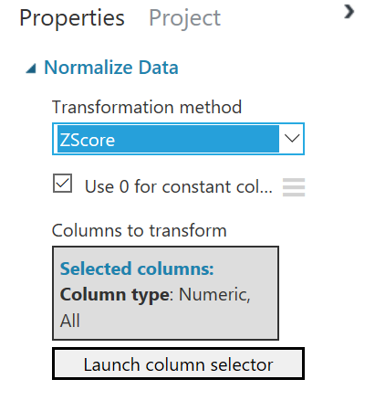
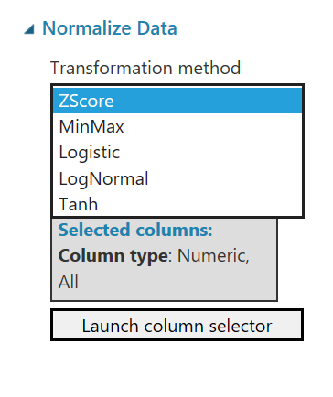
Standardized variables
Notes:
https://docs.microsoft.com/en-us/azure/machine-learning/studio-module-reference/normalize-data

Slide 72
What are the two most common reasons for using feature selection?
To increase the accuracy of model predictions.
To reduce the number of outliers in the source data.
To minimize the variance within the source dataset.
To improve the speed of the data analysis.
To increase the efficiency of the model training process.

Slide 73
What are the two most common reasons for using feature selection?
To increase the efficiency of the model training process.

Slide 74
Managing datasets
Exercise 1: Preparing the lab Exercise 2: Importing data into Machine Learning Exercise 3: Converting imported data into separate datasets
Estimated Time: 60 Minutes
https://github.com/MicrosoftLearning/20774_Perform-Cloud-Data-Science-with-Azure-Machine-Learning/blob/master/Instructions/20774A_LAB_AK_03.md

